Slide 1
Diode Analysis
By Mason Andrews

Slide 2
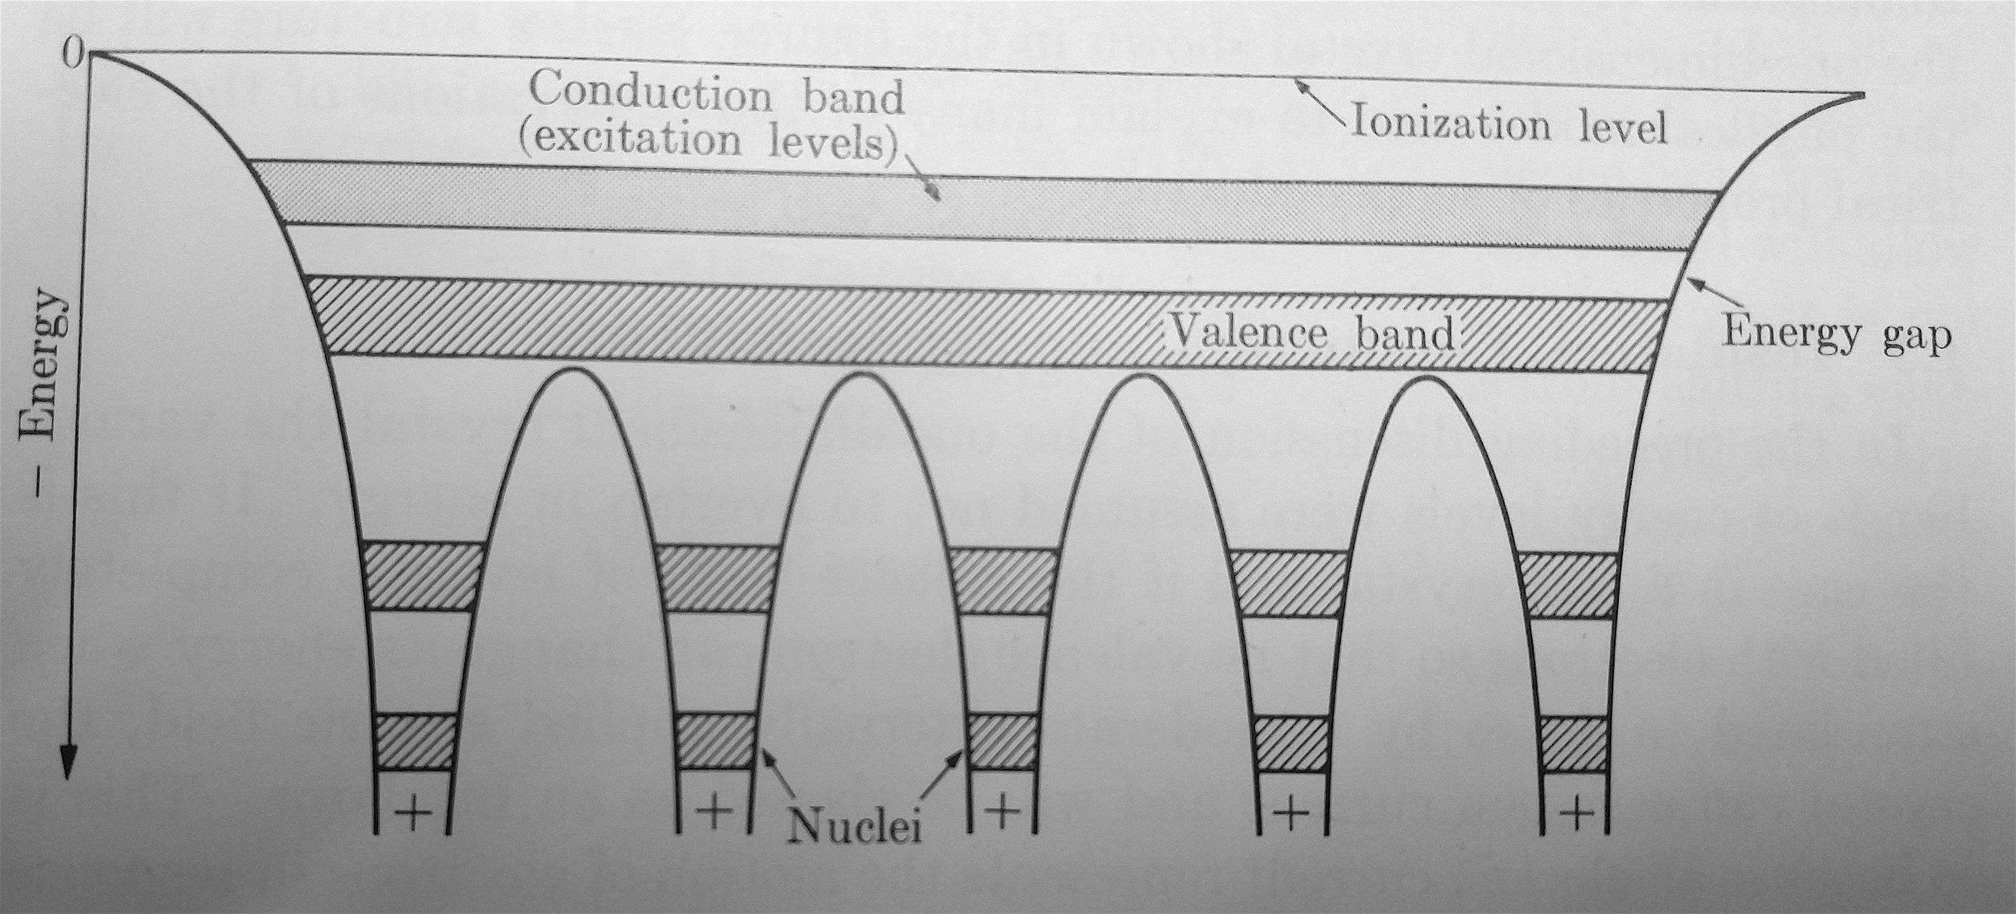

Slide 3
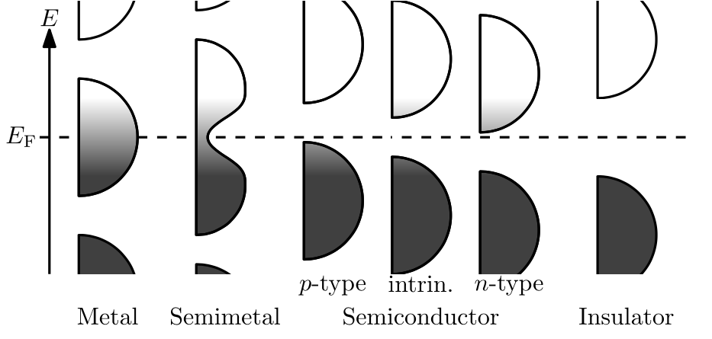

Slide 4
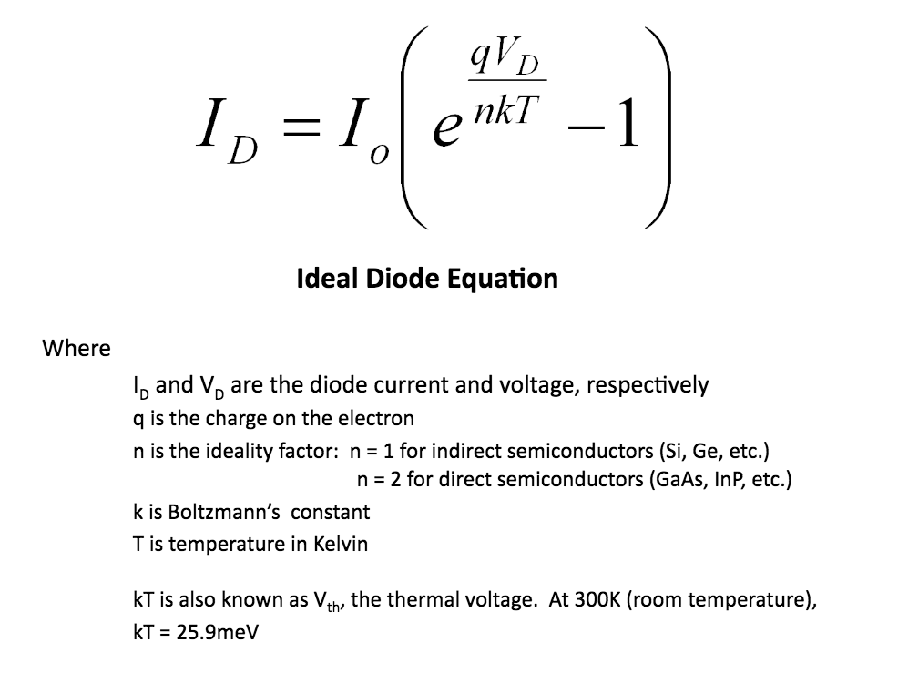

Slide 5
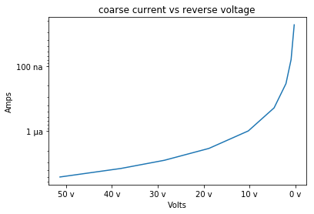
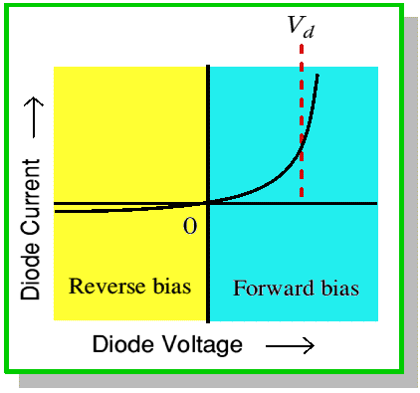
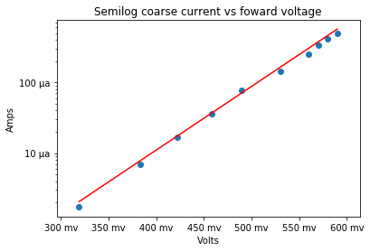

Slide 6
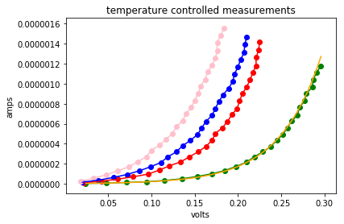

Slide 7
Bibliography
Lesely Loyd (2015) Ideal Diode Equation, https://slideplayer.com/slide/5796147/
Neudeck, G. (1983). The PN junction diode (Modular series on solid state devices ; v. 2). Reading, Mass.: Addison-Wesley.
Kip, A. (1968). Fundamentals of electricity and magnetism (2d ed., McGraw-Hill series in fundamentals of physics). New York: McGraw-Hill.
Melissinos, Adrian C., and Jim Napolitano. Experiments in Modern Physics. Academic Press, 2011.

